Slide 1
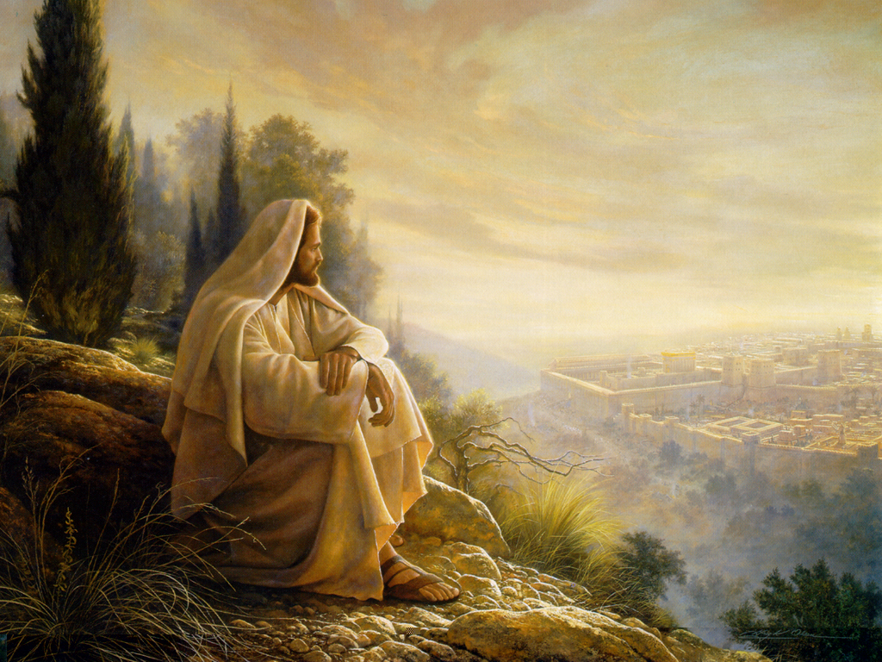
Answering the
New Covenant Perspective’s Charge on the Absence of Restoration to the Land Texts in the New Testament

Slide 2
“Home is that place, from which, once a man sets forth, he is a wanderer until he returns.” Blackstone

Slide 3

What are we, finally, to make of this doctrine of The Land which gives theological significance—as it has been crudely put—“to a piece of real estate”? Many Jews, no less than Gentiles, have dismissed it as a bizarre and anachronistic superstition, unworthy of serious consideration. To many rationalists, and even humanists, especially since the Enlightenment, in a rational universe the doctrine is an affront. This response is generally coupled with the assumption that the doctrine is simply an aspect of that other doctrine of “choseness” or “election” that - so it is claimed - has irrationally and arrogantly afflicted (a verb chosen advisedly) the Jewish people, the particularism of The Land being, in fact, an especially primitive expression of the unacceptable particularism of the Jewish faith.” - W. D. Davis

Slide 4

“Christian theologians are once again reclaiming the fact that ‘the land is central, if not the central theme of biblical faith,’ and therefore, as W. D. Davies warned, ‘it will no longer do to talk about Yahweh and his people, but we must speak about Yahweh and his people and his land.’ Likewise, Gehard von Rad summarized the situation by saying, ‘Of all the promises made to the patriarchs it was that of the land that was the most prominent and decisive.’ In fact, few issues are as important as that of the promise of the land to the patriarchs and the nation of Israel: the Hebrew word ‘erets is the fourth most frequent substantive in the Hebrew Bible.”
- Walt C. Kaiser Jr.

Slide 5

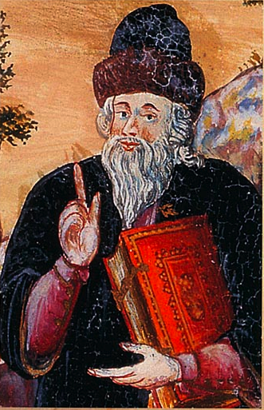
“this belief in the messiah is in accordance with the prophecies concerning him, by all the prophets, from our master moses until malachi, peace be unto them.”
Moses maimonides
The wolf shall lie with the lamb.
Translated byboteach, p. 3.

Slide 6
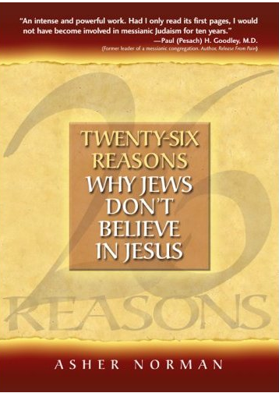
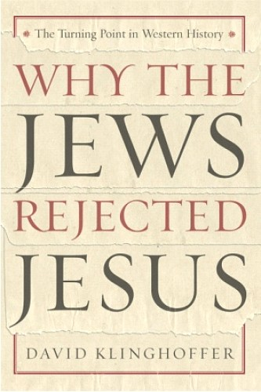

Slide 7
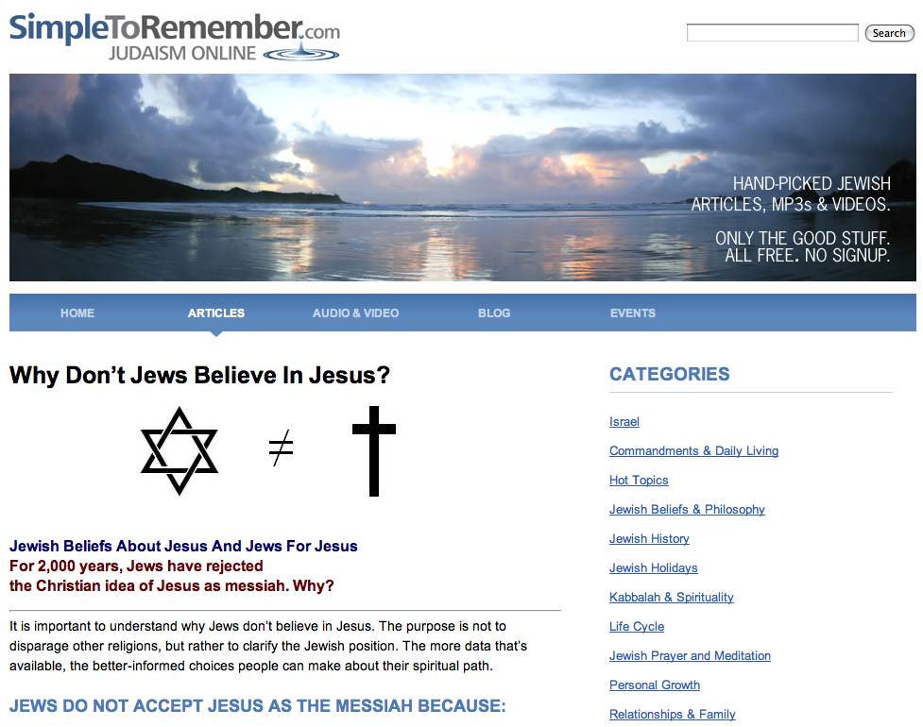
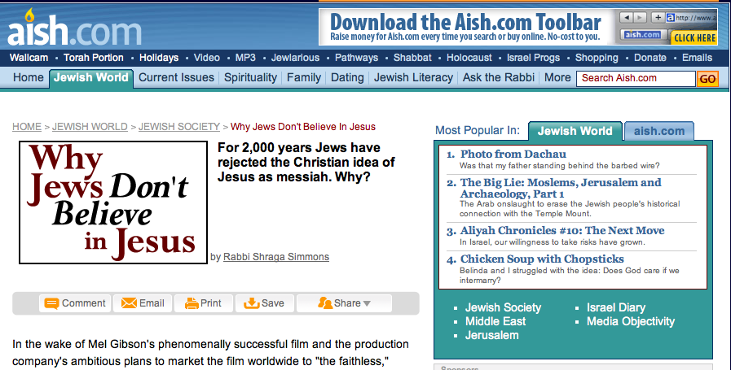

Slide 8
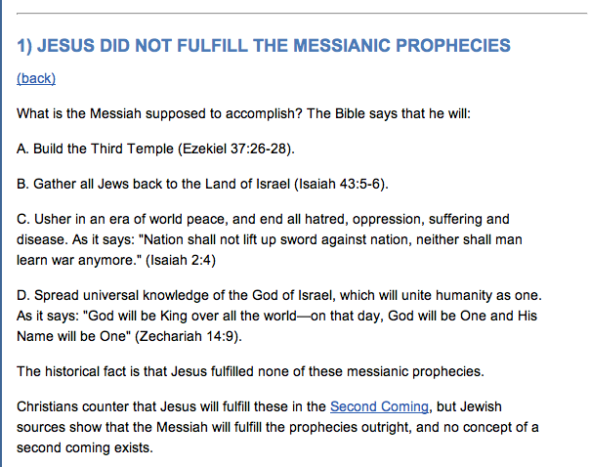
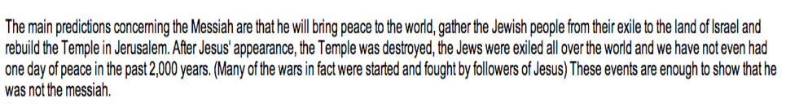

Slide 9
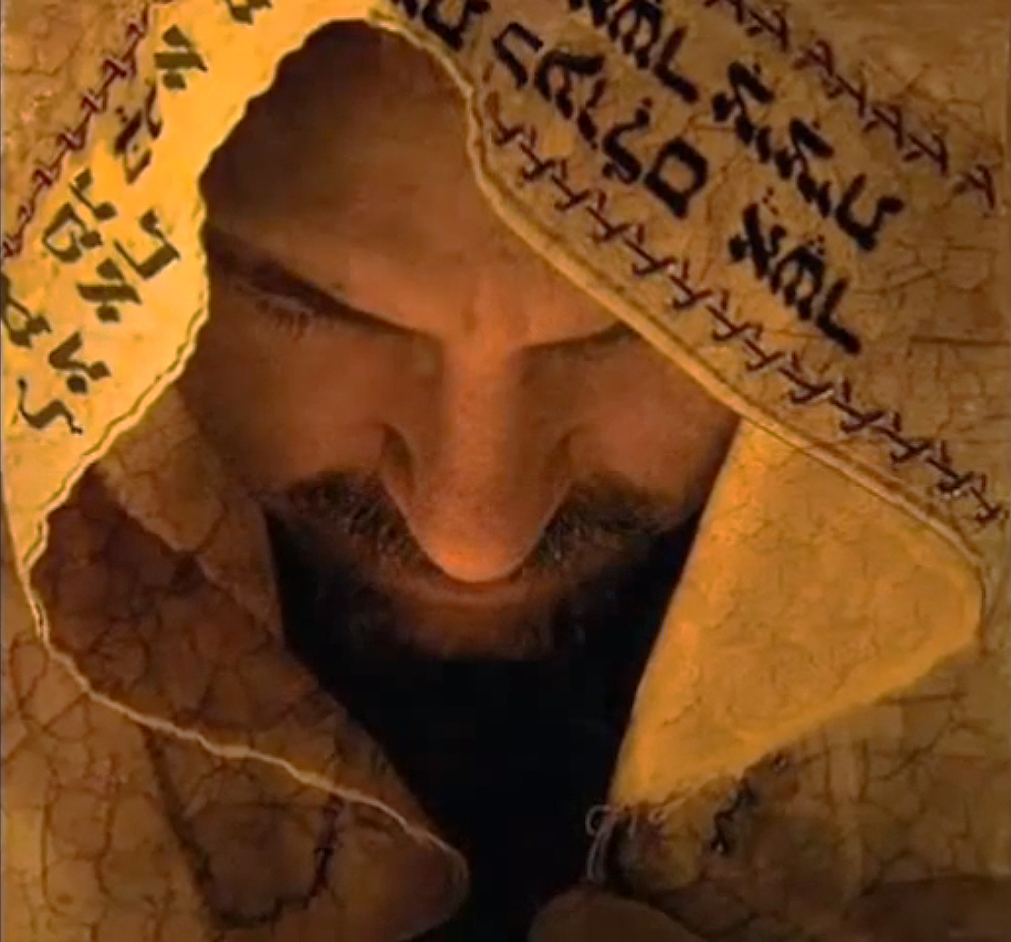
What Jesus Didn't Do
Rescue Israel from its enemies.
Regather Israel from the nations.
Reunite Israel’s twelve tribes.
Redeem Israel spiritually.
Restore Israel’s fortunes in the Land.
Reverse Israel’s place among the nations.
Rebuild Israel’s Temple.
Reign over Israel as King.
Rule over the earth in peace.
Renew Jerusalem as the center of worship.

Slide 10
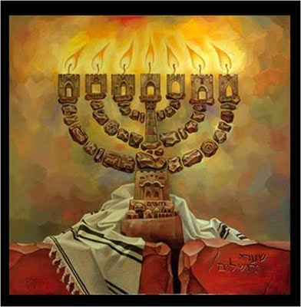
Why Didn’t Jesus Do It?
3 Possible Answers
1. He couldn't do it (He wasn't the Messiah)
Traditional
Judaism
2. He did do it (but spiritually, not literally)
Covenantalism
3. He will do it (but hasn't done it yet)
Futurism

Slide 11
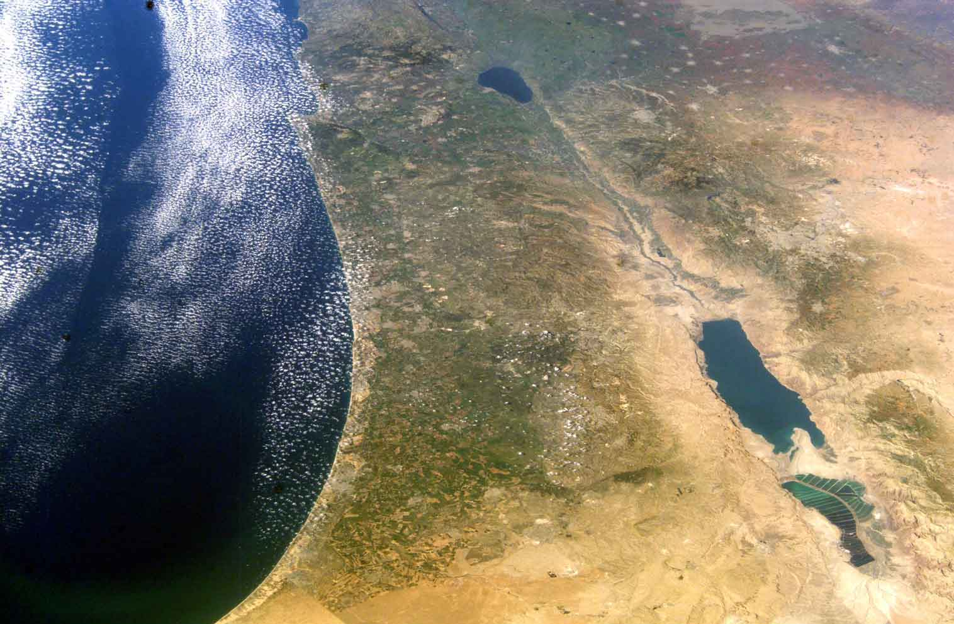
“Christians and Muslims, it is commonly said, differ from Jews in the nature of the holiness ascribed to the Land of Israel: the former have holy memories and holy places here, while for Jews the Land itself is holy. To Jews, every other land is an exile, but whatever happens here is significant, and the people living in the land are called to be a holy people.” - Moshe Greenberg

Slide 12

Jesus seems to be silent about the subject of the land because for him the theme of the kingdom of God took the place of the theme of the land and everything else associated with it in the Old Testament. He used language from the Old Testament about the land, the ingathering of the exiles to the land and the redemption or restoration of the nation of Israel to describe his own ministry.”
“Is there anything to suggest that after the ascension of Jesus his disciples continued to look forward to a restored Jewish state in the Land? Given the political situation in first-century Palestine, the writers of the New Testament had every reason to hope for a national restoration for the Jewish people. But did they in fact do so? There is nothing whatsoever to suggest that they held onto these hopes.”
  Colin Chapman, Whose Promised Land?:, pp. 161-62

Slide 13
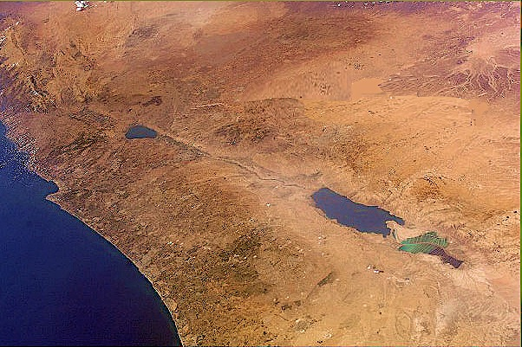
Hermeneutical Issues Concerning the Land
under the New Covenant
(1) The Literary Motivation Interpretation
(2) The Cosmic Reinterpretation Interpretation
(3) The Christological Transformation Interpretation
(4) The Past Fulfillment Interpretation
(5) The Present Fulfillment Interpretation

Slide 14
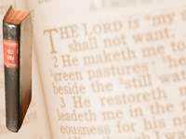
New Perspective’s Method
New Testament
christocentric lens
Historical/
Prophetic
Spiritual/
Soterological
O
L
D
T
E
S
T
A
M
E
N
T
Transforms and Reinterprets
OT promises to national Israel
Redefines under New Covenant

Slide 15

The New Testament writers “ceased to look forward to a literal fulfilment of Old Testament prophecies of a return to the land and a restored Jewish state. The one and only fulfilment of all the promises and prophecies was already there before their eyes in the person of Jesus.”

Slide 16
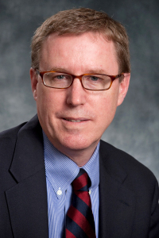
“Jesus does not envision a restoration of Israel per se but instead sees himself as embracing the drama of Jerusalem within his own life … In some manner, the initial restoration of Israel has already begun inasmuch as Christ, the new Temple, the New Israel, has been resurrected.”
Gary Burge, Wheaton College

Slide 17
“This (Gal. 6:16) is perhaps the apostle’s most stark example of universalizing the new identity of the people of God. The apostle is redrawing the definitions for self-identity … And with this redefinition comes a realignment of the privileges that come with all identities.”
Gary Burge, Wheaton College

Slide 18
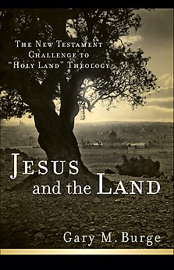
“At no point do the earliest Christians view the Holy Land as a locus of divine activity to which the people of the Roman empire must be drawn. They do not promote the Holy Land either for the Jew or for the Christian as a vital aspect of faith. No Diaspora Jew or pagan Roman is converted and then reminded of the im-portance of the Holy Land. The early Christians possessed no territorial the-ology. Early Christian preaching is utterly uninterested in a Jewish eschatology devoted to the restoration of the land. The kingdom of Christ began in Judea and is historically anchored there but it is not tethered to a political realization of that kingdom in the Holy Land. Echoing the message of the Gospels, the praxis of the Church betrays its theological commit-ments: Christians will find in Christ what Judaism had sought in the land.”

Slide 19
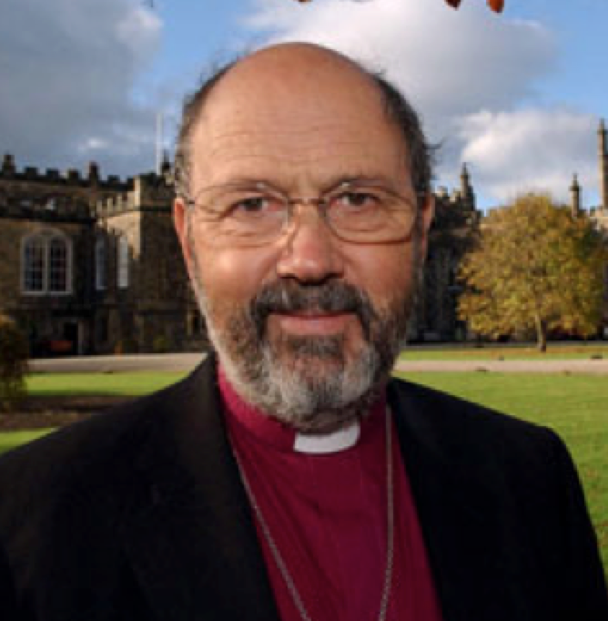
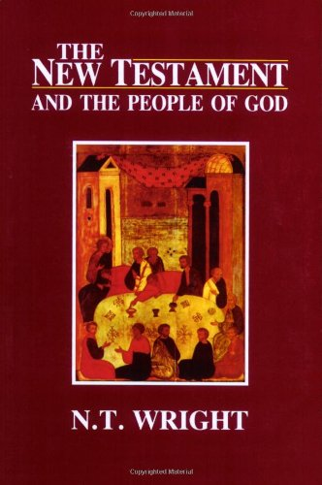
“Israel’s story has been embodied in one man”
(p.402)
“the whole story of Israel … reached its intended climax with his death [exile] and resurrection [restoration]” (p.366)
“the church … seems to have taken the place occupied … by (Jewish) ethnic identity” (p.367)
Notes:
Vol. 1 of 5 (Christian Origins and the Question of God)

Slide 20
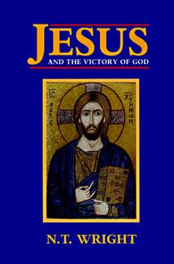
The Lord Jesus was:
“reconstituting Israel around himself” (p.131)
“reinterpreting” Israel’s eschatological hope (p.241)
“reusing Israel’s prophetic heritage, and retelling its story” (p.349)
“redefining what the kingdom meant” (p.471)

Slide 21
“The promises to Jerusalem, to Zion, are now transferred to Jesus and his people.”

Slide 22

    “The entitlement of any one ethnic or religious group to territory in the Middle East called the "Holy Land" cannot be supported by Scripture … No New Testament writer foresees a regathering of ethnic Israel in the land …”
Knox Seminary Open Letter

Slide 23
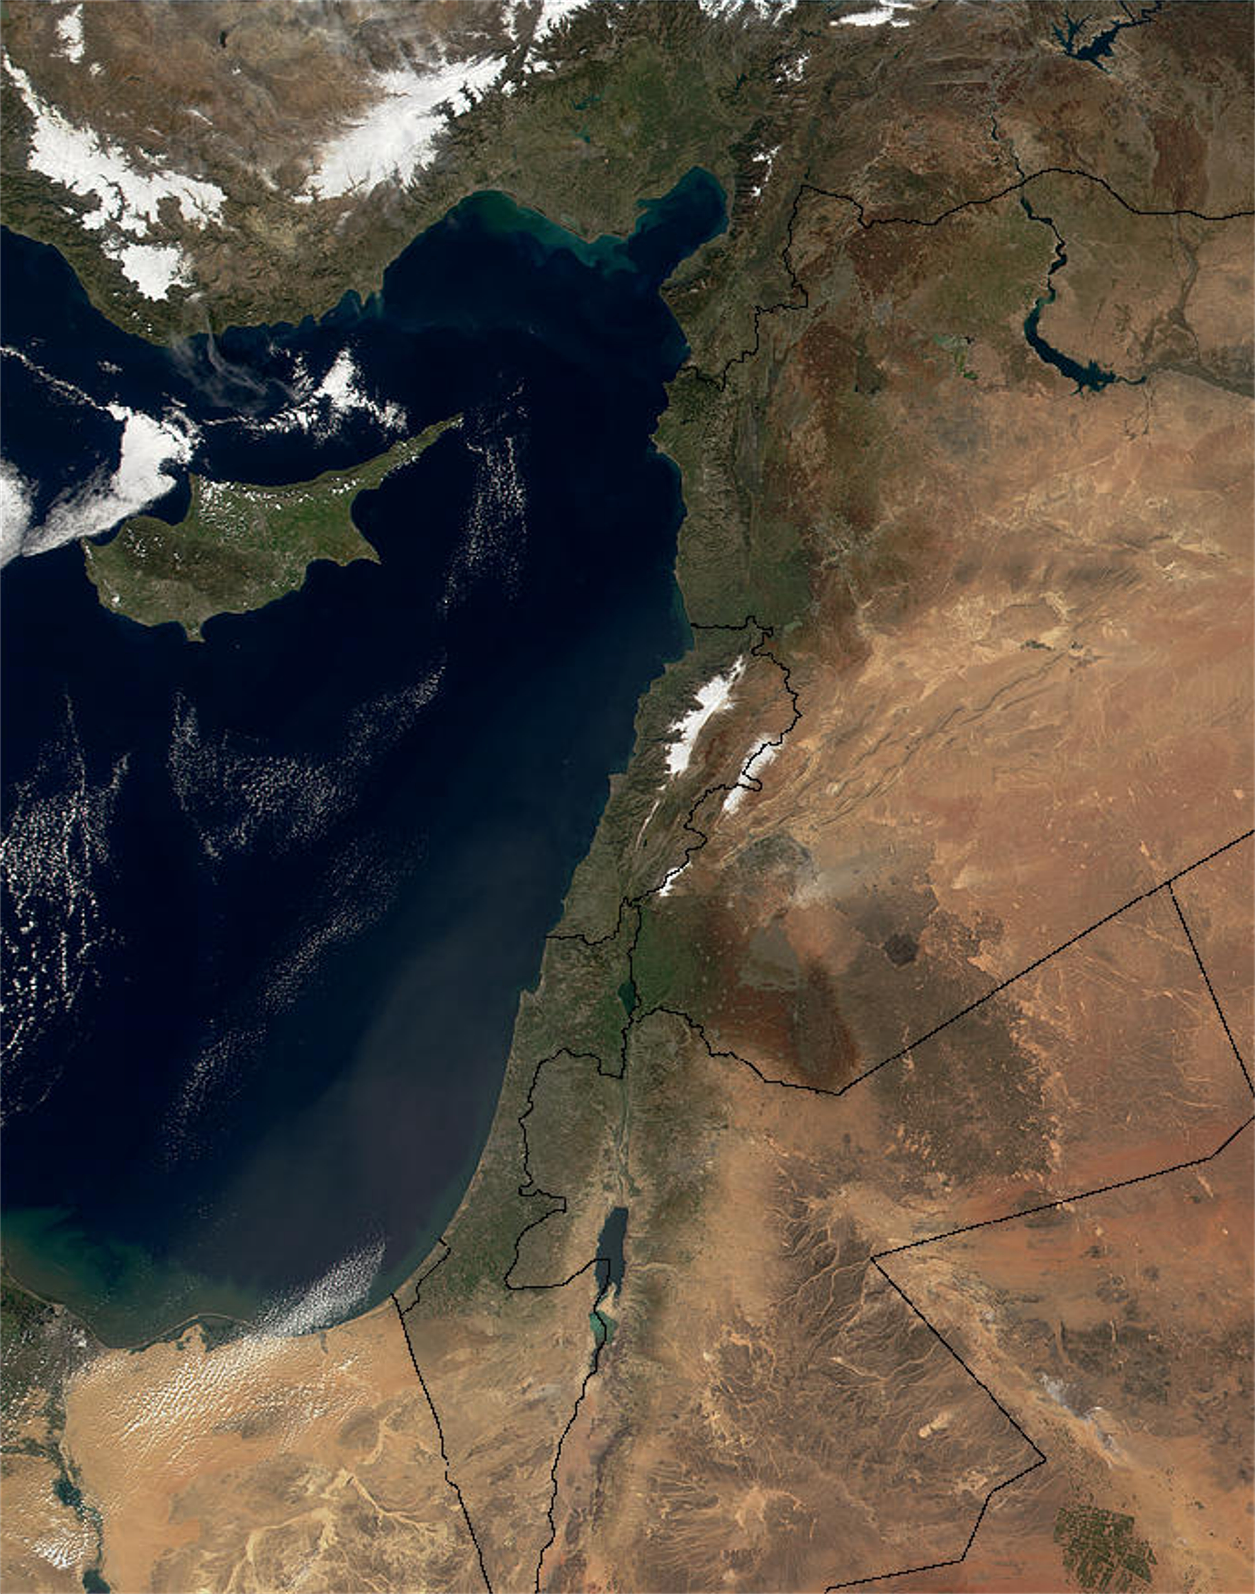
“And I will establish My covenant between Me and you and your descendants after you throughout their generations for an everlasting covenant, to be God to you and to your descendants after you. And I will give to you and to your descendants after you, the land of your sojournings, all the land of Canaan, for an everlasting possession …” Genesis 17:7-9 `
‏וַהֲקִמֹתִ֨י אֶת־בְּרִיתִ֜י בֵּינִ֣י וּבֵינֶ֗ךָ וּבֵ֨ין זַרְעֲךָ֧ אַחֲרֶ֛יךָ לְדֹרֹתָ֖ם לִבְרִ֣ית עוֹלָ֑ם לִהְי֤וֹת לְךָ֙ לֵֽאלֹהִ֔ים וּֽלְזַרְעֲךָ֖ אַחֲרֶֽיךָ׃‎ ‏וְנָתַתִּ֣י לְ֠ךָ וּלְזַרְעֲךָ֨ אַחֲרֶ֜יךָ אֵ֣ת ׀ אֶ֣רֶץ מְגֻרֶ֗יךָ אֵ֚ת כָּל־אֶ֣רֶץ כְּנַ֔עַן לַאֲחֻזַּ֖ת עוֹלָ֑ם

Slide 24
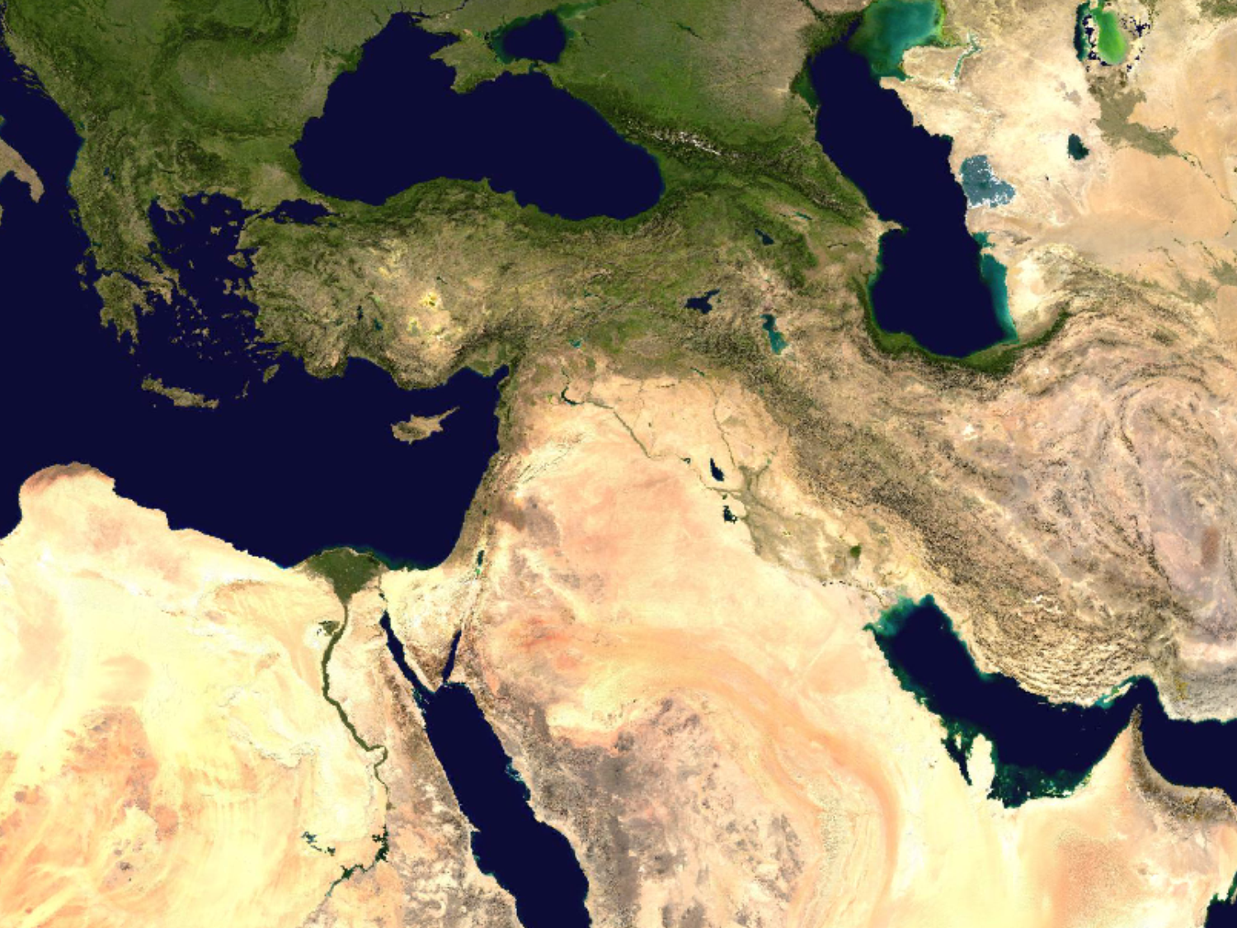
"And they shall live on the Land
that I gave to Jacob My servant,
in which your fathers lived; and
they will live on it, they, and
their sons, and their sons' sons,
forever …" Ezekiel 37:25
וְיָשְׁב֣וּ עַל־הָאָ֗רֶץ אֲשֶׁ֤ר נָתַ֙תִּי֙ לְעַבְדִּ֣י לְיַֽעֲקֹ֔ב אֲשֶׁ֥ר יָֽשְׁבוּ־בָ֖הּ אֲבֽוֹתֵיכֶ֑ם וְיָשְׁב֣וּ עָלֶ֡יהָ הֵ֠מָּה וּבְנֵיהֶ֞ם וּבְנֵ֤י בְנֵיהֶם֙ עַד־עוֹלָ֔ם וְדָוִ֣ד עַבְדִּ֔י נָשִׂ֥יא לָהֶ֖ם לְעוֹלָֽם׃

Slide 25
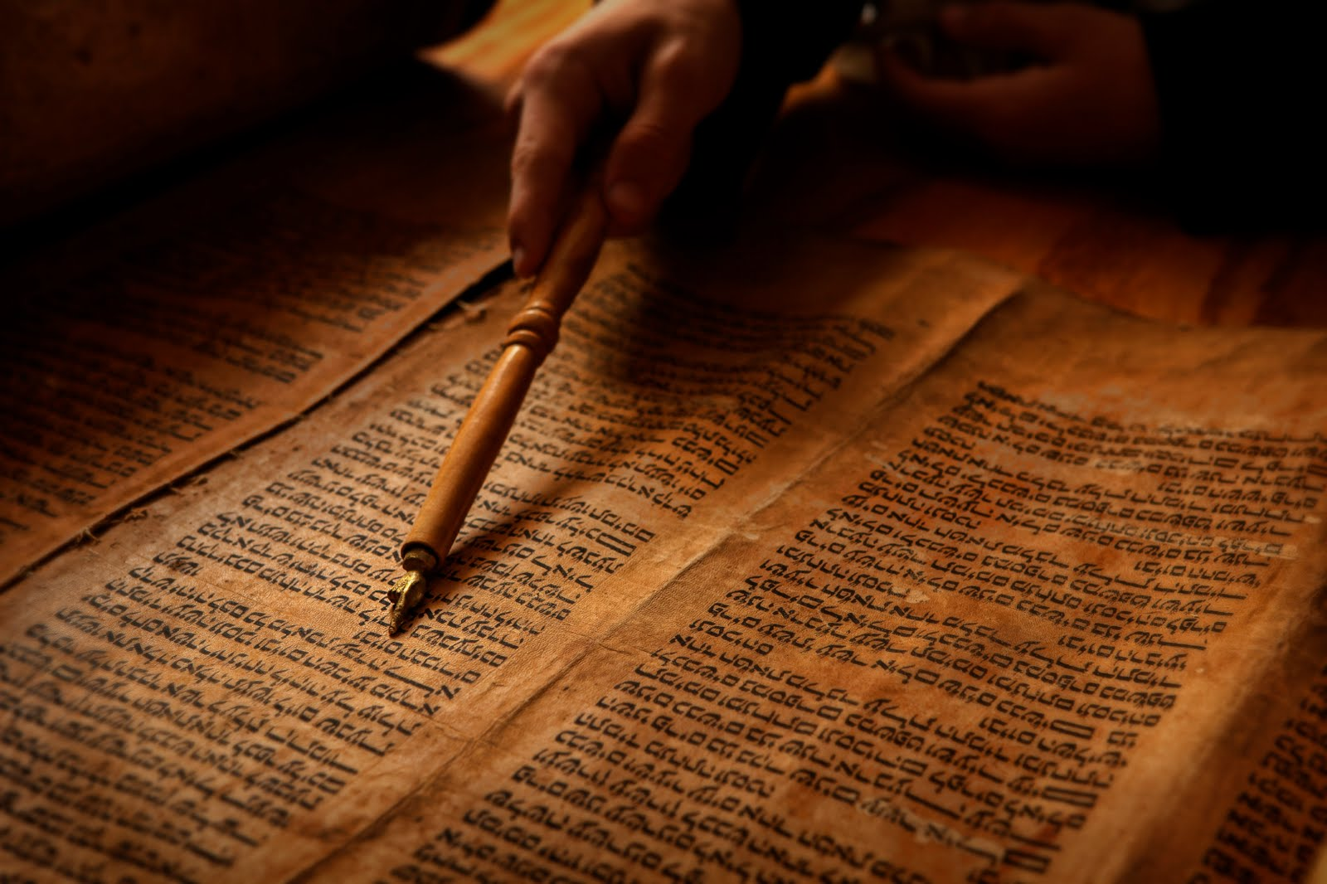
“… then I will let you dwell in this place, in the land that I gave to your fathers forever and ever.”
Jeremiah 7:7
“Turn now everyone from his evil way and from the evil of your deeds, and dwell on the land which the LORD has given to you and your forefathers forever and ever.”
Jeremiah 25:5

Slide 26
<lwu /m
<lwu duw
(min ‘olam v’ad ‘olam)
“forever and ever”

Slide 27
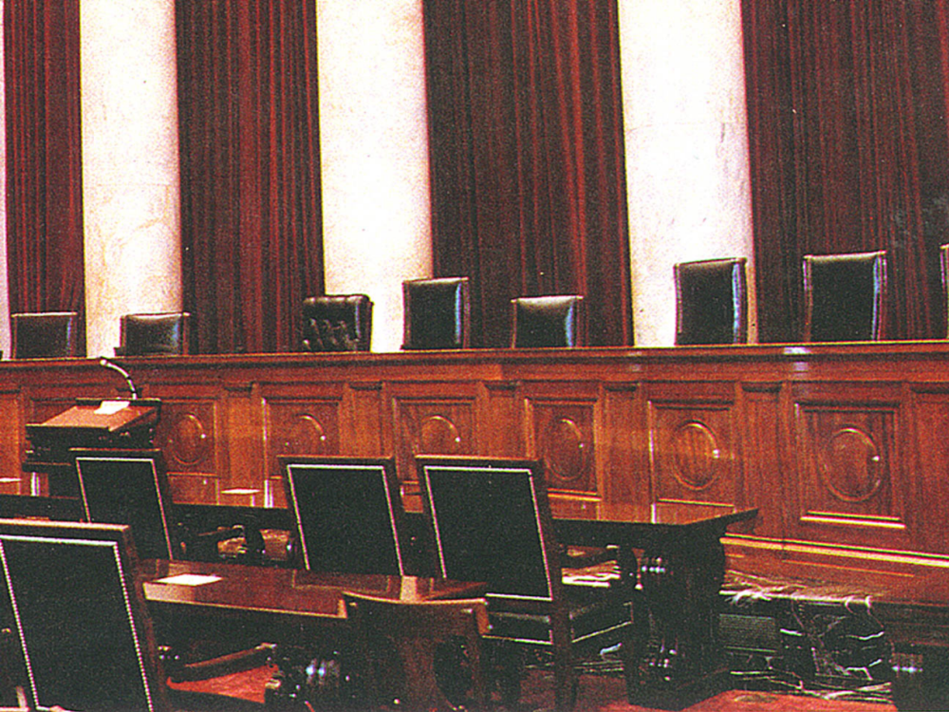
A legal contract made between two parties requires a “meeting of the minds.” This means that in agreeing to the terms of the contract, each party must understand unambiguously the intention of the other
to fulfill what has been promised.

Slide 28
ABRAHAMIC COVENANT
ABRAHAMIC
COVENANT
Genesis 12:1-13
“land”
“seed”
“blessing”
ISRAEL LAND
COVENANT
DAVIDIC
COVENANT
NEW
COVENANT
Deuteronomy 30
2 Samuel 7
Jeremiah 31
“land”
“seed”
“blessing”

Slide 29

RELATIONSHIPS OF THE NEW COVENANT
The New Covenant
given to
participate in
fulfilled by
not fulfilled by
Israel
Church

Slide 30

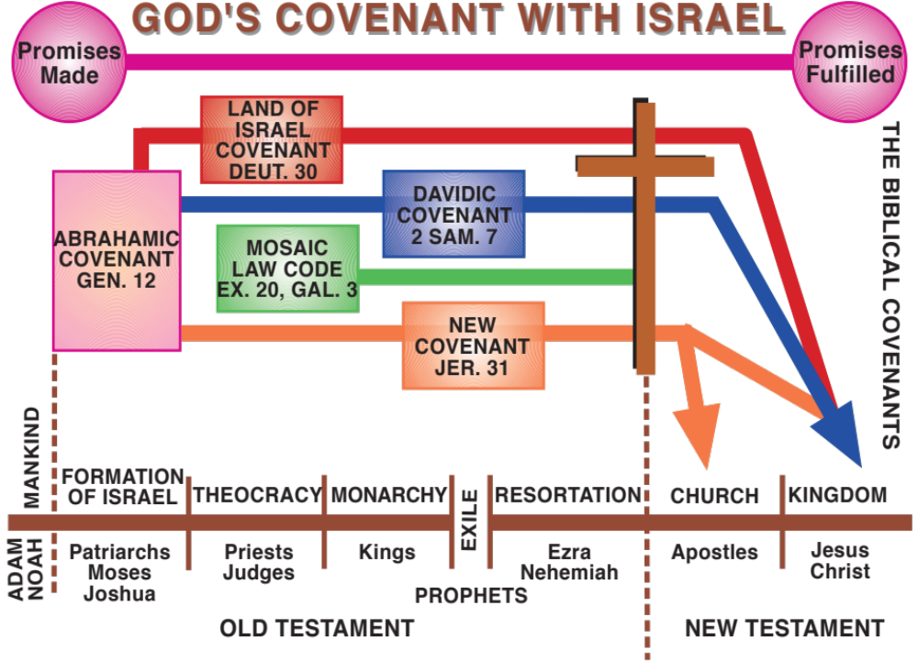

Slide 31
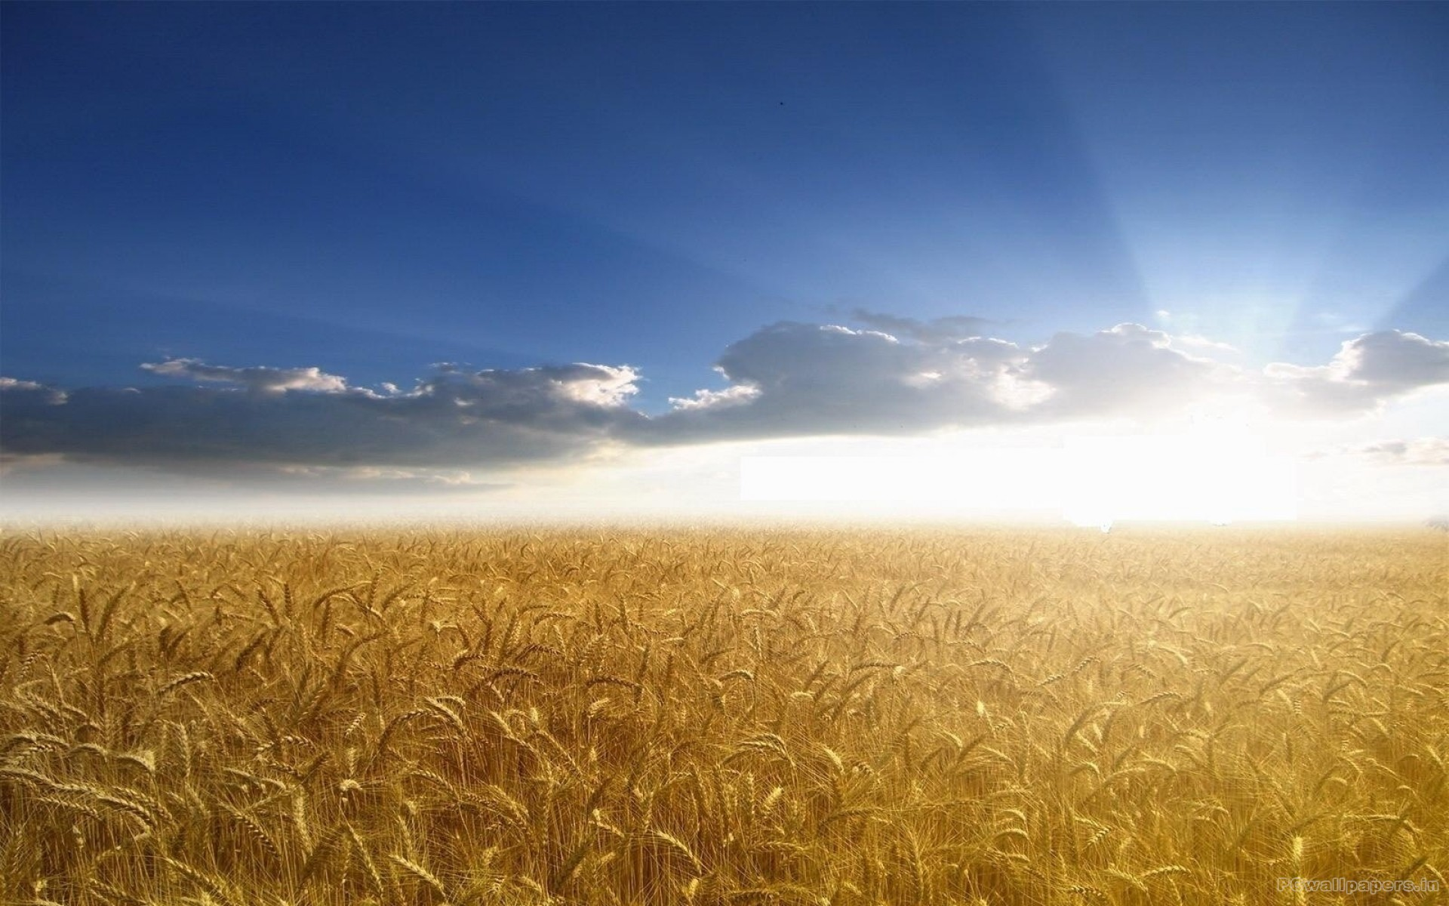
“This hope is not redefined or clarified in the new era in a way that old promises are lost. It is the hope of the ages for the nation. It is the restoration of order with Israel having a central role … There is a kingdom hope that applies to Israel and that is explained in what is now called the Old Testament. The existence of the church has not canceled that hope for Israel.”

Slide 32
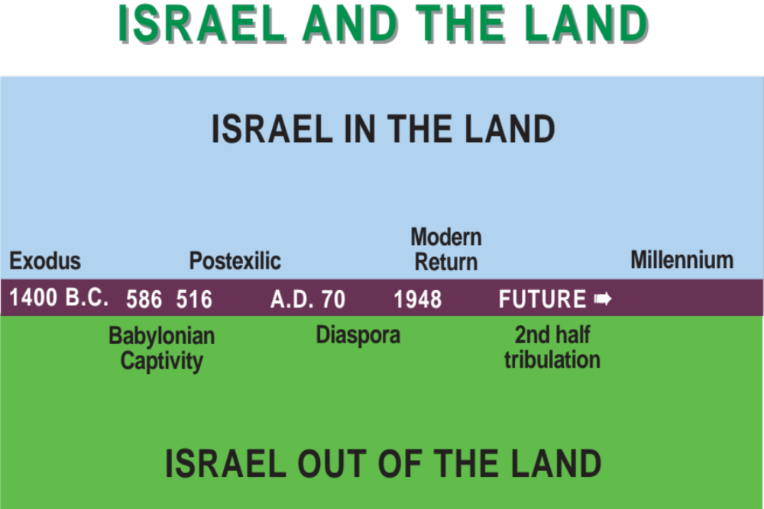
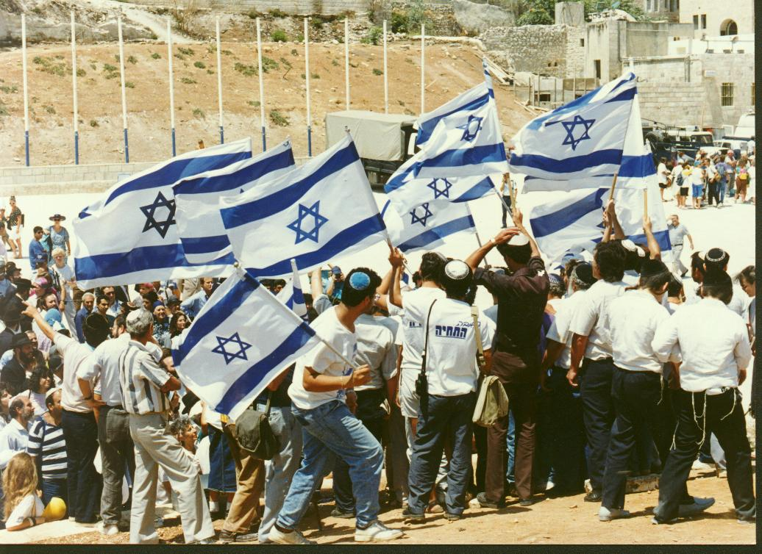
Israel and the Land
"Times of the Gentiles" (Luke 21:24)
ISRAEL IN
THE LAND
Remnant
In the
Land
ISRAEL IN THE LAND
Second Advent
"Period of Indignation" (Daniel 8:19)

Slide 33


Relationship of Israel and the Gentiles in the Church
CHURCH
NATIONAL
ISRAEL
JEWISH
REMNANT
GENTILE
REMNANT
GENTILE
NATIONS
Rom. 11:17,
20-21
Rom. 3:1-2;
10:1; 11:14
Rom. 11:5
Gal. 6:16
Matt. 21:43
Rom. 2:28-29
Rom. 11:11,
24a; Acts 10:35;
15:3, 6-11,14
Gen. 10:32
Eph. 2:11-12
Acts 17:26
Eph. 2:13-
22; 3:1-12
Rom. 16:25
“Christ has become a servant to the circumcision on behalf of the truth of God to confirm the promises given to the fathers, and for the Gentiles to glorify God for His mercy” Romans 15:8-9

Slide 34
Discontinuity in the Church and Israel in the New Covenant
NEW COVENANT (NC1)
NEW COVENANT (NC2)
Church Participates
National Israel Fulfills
National Israel Rejects Messiah
National Israel Accepts Messiah
Remnant of National Israel
Receives Partial Blessings
Remnant of National Israel
Receives Promised Blessings
Gentile Remnant included in
Partial Blessings of New Covenant
National Israel Mediates to Gentiles
Full Blessings of New Covenant
Land under Divine Discipline
Land under Divine Blessing
Part of National Israel Outside Land
All of National Israel in the Land
Partial Possession of Partial Land
Full Possession of Promised Land
Spiritual Temple and Spiritual Priesthood
Functioning Temple and Levitical Priesthood
Spiritual Temple Indwelt by Messiah
Physical Temple is Throne of Messiah
Provisional Atonement by Spiritual Confession
Provisional Atonement by Ritual Sacrifice
God’s Name Profaned by the Nations
God’s Name Glorified by the Nations

Slide 35
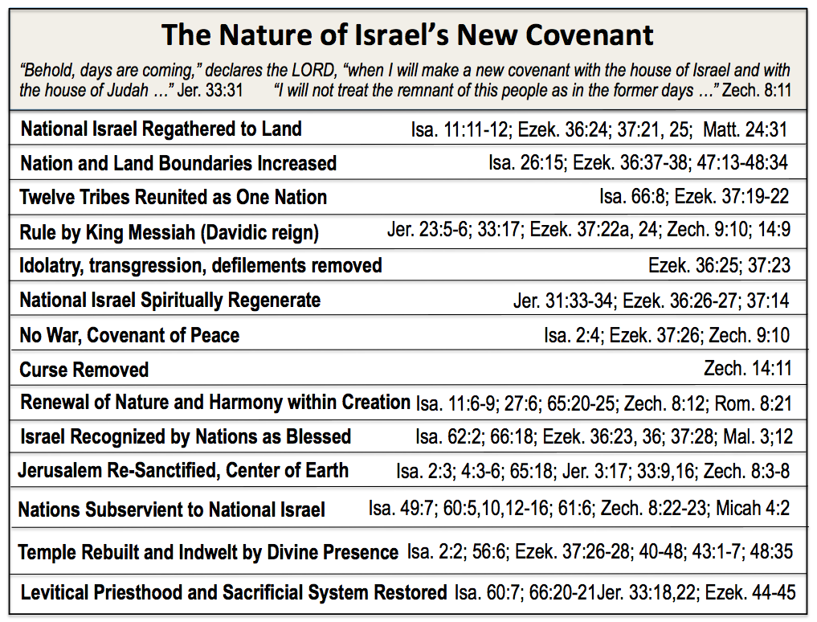
THE NATURE OF THE NEW COVENANT
“Behold, days are coming, declares the LORD, when I will make a new covenant with the house of Israel and with
The house of Judah …” Jer. 33:31 “I will not treat the remnant of this people as in the former days …” Zech. 8:11
Eternal (five-fold repetition of “forever”)
Isa. 24:5; 61:8; Jer. 31:36, 40; 32:40; 50:5

Slide 36
Israel and the Land under the New Covenant
TIMES OF THE GENTILES
TIME OF ISRAEL’S RESTORATION
CHURCH AGE
TRIBULATION
MILLENNIUM
National
Israel
Presently excluded
Remnant included
Provisionally included
via Remnant of national Israel
(Jer. 30:7b; Zech. 12:10-13:1)
Included (as head)
Deut. 28:13; Isa. 12:6;
60:14-16; 62:2
Gentile
nations
Presently excluded
Remnant included
Provisionally included
via Remnant of national Israel
(Matt. 25:32-46)
Included (as tail)
Isa. 2:3; 60:10-12;
Zech. 9:23
Land
Under divine discipline
(Daniel 8:19; Luke 21:24)
Under divine wrath
(Rev. 6-19)
Restored and Renewed
(Isa. 27:6; 60:21; 62:4;
Ezek. 36:34-36)

Slide 37
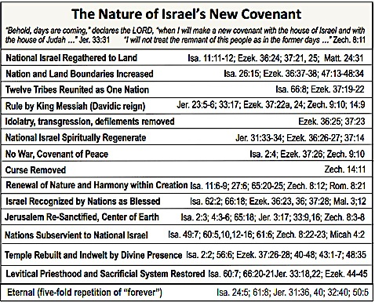
THE NATURE OF ISRAEL’S NEW COVENANT

Slide 38

Restoration to the Land Texts in the NT
Matthew 5:5
Matthew 8:11/Luke 13:29
Matthew 19:28/Luke 22:30
Matthew 23:37-39/Luke 13:34-35
Matthew 25:31-46
Matthew 26:29/Mark 14:25
Acts 1:6-7; 3:19-21

Slide 39
What about the land promises? They are not mentioned in the NT. Are they, therefore, canceled?” In my opinion the apostles and the early church would have regarded the question as singularly strange, if not perverse. To them the Scriptures consisted of our OT, and they considered the Scriptures to be living and valid as they wrote and transmitted the NT literature. The apostles used the Scriptures as if they were living, vital oracles of the living God, applicable to them in their time. And these same Scriptures were filled with promises regarding the land and an earthly kingdom. On what basis should the Abrahamic promises be divided into those to be fulfilled and those to remain unfulfilled? Finally, there is no need to repeat what is copiously spread over the pages of the Scriptures. There seems to be lurking behind the demand a false principle, namely, that we should not give heed to the OT unless its content is repeated in the New. S. Lewis Johnson, Jr.

Slide 40

Matthew 5:5
“Blessed are the afflicted, for they shall inherit the Land.”
μακάριοι οἱ πραεῖς, ὅτι αὐτοὶ κληρονομήσουσιν τὴν γῆν.
Isaiah 61:1, 7
“To bring good news to the afflicted … “Therefore they will inherit a double portion in their land …”
לְבַשֵּׂ֣ר עֲנָוִ֗ים שְׁלָחַ֙נִי֙
MT
וּכְלִמָּ֖ה יָרֹ֣נּוּ חֶלְקָ֑ם לָכֵ֤ן בְּאַרְצָם ֙
LXX
εὐαγγελίσασθαι πτωχοῖς ἀπέσταλκέν με …
οὕτως ἐκ δευτέρας κληρονομήσουσιν τὴν γῆν

Slide 41

The “earth” (τὴν γῆν) originally referred to the land of Israel, ie, what was promised to the Jews beginning with the Abrahamic covenant (cf Gen 13:15). But in the present context of messianic fulfillment it connotes the regenerated earth (19:28; cf Rom 4:13, where κόσμος, “world,” replaces γῆ [“land”], promised by the eschatological passages in the prophets (eg, Isa 65–66).”
Donald A. Hagner, Matthew 1-13. Word Biblical Commentary. 33A (Nashville: Thomas Nelson, 2000), p. 93.

Slide 42

“That Abraham should be “heir of the world” might seem an odd rendering of the promises of Gen 12:2–3 and 15:5, even in their subsequent form (17:4; 18:18; 22:17–18). But in fact this was how the promise to Abraham was regularly understood. Indeed it had become almost a commonplace of Jewish teaching that the covenant promised that Abraham’s seed would “inherit the earth.” It is not by accident that Paul takes up this more grandiose form of the promise - the promise to Abraham or his seed (we might say “through his seed”) that he should inherit the world. For the promise thus interpreted was fundamental to Israel’s self-consciousness as God’s covenant people: it was the reason why God had chosen them in the first place from among all the other nations of the earth, the justification for holding themselves distinct from the other nations, and the comforting hope that made their current national humiliation endurable.”
Janes D.G. Dunn, Romans 1-8. Word Biblical Commentary 38A: 233

Slide 43
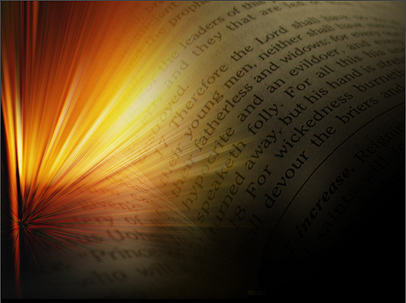
Matthew 8:11; Luke 13:29
Matthew 26:29/Mark 14:25
“And I say to you, that many shall come from east and west, and recline at the table with Abraham, and Isaac, and Jacob, in the kingdom of heaven.”
λέγω δὲ ὑμῖν ὅτι πολλοὶ ἀπὸ ἀνατολῶν καὶ δυσμῶν ἥξουσιν καὶ ἀνακλιθήσονται μετὰ Ἀβραὰμ καὶ Ἰσαὰκ καὶ Ἰακὼβ ἐν τῇ βασιλείᾳ τῶν οὐρανῶν,
“And they will come from east and west, and from north and south, and will recline at the table in the kingdom of God.”
καὶ ἥξουσιν ἀπὸ ἀνατολῶν καὶ δυσμῶν καὶ ἀπὸ βορρᾶ καὶ νότου καὶ ἀνακλιθήσονται ἐν τῇ βασιλείᾳ τοῦ θεοῦ.

Slide 44
Matthew 26:29/Mark 14:25
“But I say to you, I will not drink of this fruit of the vine from now on until that day when I drink it new with you in My Father’s kingdom.”
“Truly I say to you, I shall never again drink of the fruit of the vine until that day when I drink it new in the kingdom of God.”

Slide 45
Matthew 19:28; Luke 22:30
“And Jesus said to them, “Truly I say to you, that you who have followed Me, in the regeneration when the Son of Man will sit on His glorious throne, you also shall sit upon twelve thrones, judging the twelve tribes of Israel.”
ὁ δὲ Ἰησοῦς εἶπεν αὐτοῖς· ἀμὴν λέγω ὑμῖν ὅτι ὑμεῖς οἱ ἀκολουθήσαντές μοι ἐν τῇ παλιγγενεσίᾳ, ὅταν καθίσῃ ὁ υἱὸς τοῦ ἀνθρώπου ἐπὶ θρόνου δόξης αὐτοῦ, καθήσεσθε καὶ ὑμεῖς ἐπὶ δώδεκα θρόνους κρίνοντες τὰς δώδεκα φυλὰς τοῦ Ἰσραήλ.
“that you may eat and drink at My table in My kingdom, and you will sit on thrones judging the twelve tribes of Israel.”
ἵνα ἔσθητε καὶ πίνητε ἐπὶ τῆς τραπέζης μου ἐν τῇ βασιλείᾳ μου, καὶ καθήσεσθε ἐπὶ θρόνων τὰς δώδεκα φυλὰς κρίνοντες τοῦ Ἰσραήλ.

Slide 46
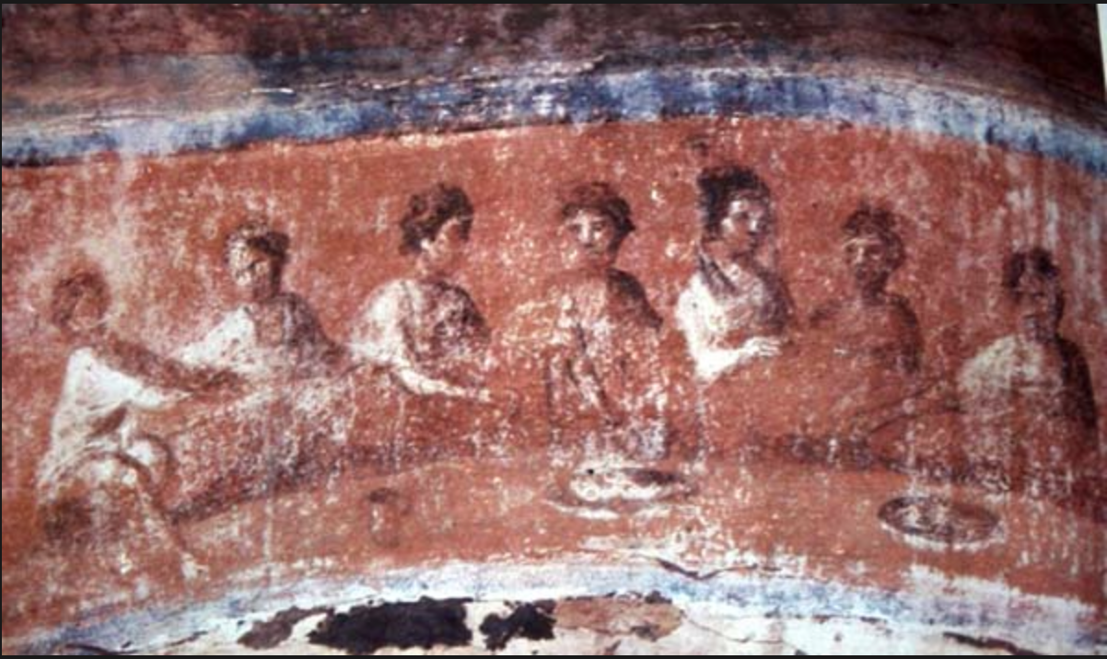
“And the LORD of hosts will prepare a lavish banquet for all peoples on this mountain; a banquet of aged wine, choice pieces with marrow, and refined, aged wine. And on this mountain He will swallow up the covering, which is over all peoples, even the veil, which is stretched over all nations. He will swallow up death for all time,
and the Lord GOD will wipe tears away from all faces, and He will remove the reproach of His people from all the earth; for the LORD has spoken. And it will be said in that day, “Behold, this is our God for whom we have waited that He might save us. This is the LORD for whom we have waited; Let us rejoice and be glad in His salvation.” Isaiah 26:6-9

Slide 47
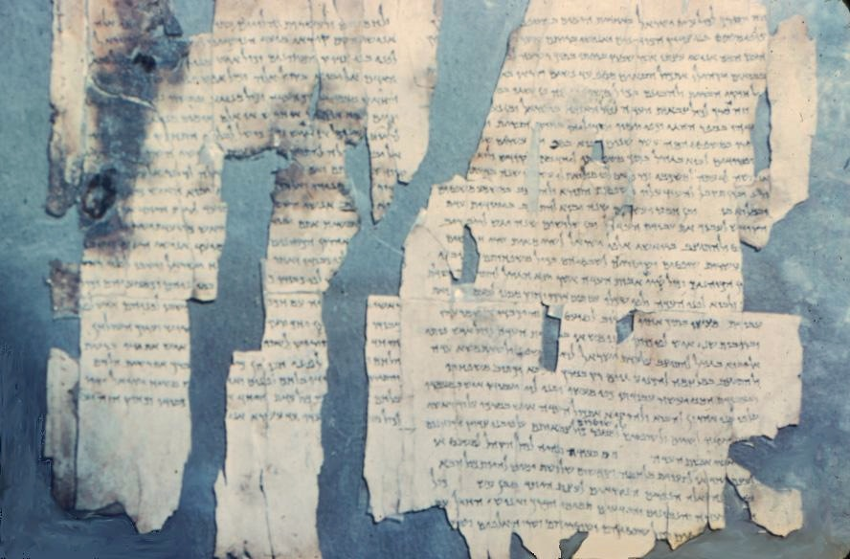
THE MESSIANIC BANQUET AT QUMRAN
1QSa (Rule of the Congregation)

Slide 48
Messianic Rule (1QS 1.11-22) Princeton Theological Seminary Dead Sea Scrolls Project Volume 1
11 [Th]is [(is) the ses]sion of the men of the name [who are invited to] the feast, the men of the
name. And they shall sit
12 [God] leads forth the Messiah (to be) with them: [The Priest] shall enter [at] the head of all
the Congregation of Israel and all
13 [his] br[others, the Sons of] Aaron, the Priests [who are invited to] the feast, the men of the
name. And they shall sit
14 be[fore him each man] according to his glory. And after (them) the [Messi]ah of Israel [shall
enter]. And the heads of
15 the t[housands of Israel] shall sit before him [each m]an according to his glory. (And they shall
sit before the two of them, each) according to [his rank] in their camps and their journeys. And all
16 the heads of the ma[gistrates fo the Congrega]tion with [their sage[s and their knowledgable ones] shall sit before them, each man according to
17 his glory. And [when they] (solemnly) meet together [at a tab]le of the Community [to set out bread and new w]ine, and to arrange the table of
18 the Community [to eat and] to dri[nk] ne[w wi]ne, no man [shall stretch out] his hand to the first portion of
19 the bread or [the new wi]ne before the priest; fo[r he shall] bless the first portion of the bread
20 and the new wi[ne, and shall stretch out] his hand to the bread first of all. And aft[er (this has occurred)] the Messiah of Israel [shall stret]ch out his hands
21 to the bread. [And after that] all the Congregation of the Community [shall ble]ss (and partake), each ma[n according to] his glory. And [they] shall act according to this statute
22 whenever (the meal) [is arr]anged, [when] as many as ten me[n] (solemnly) meet together

Slide 49
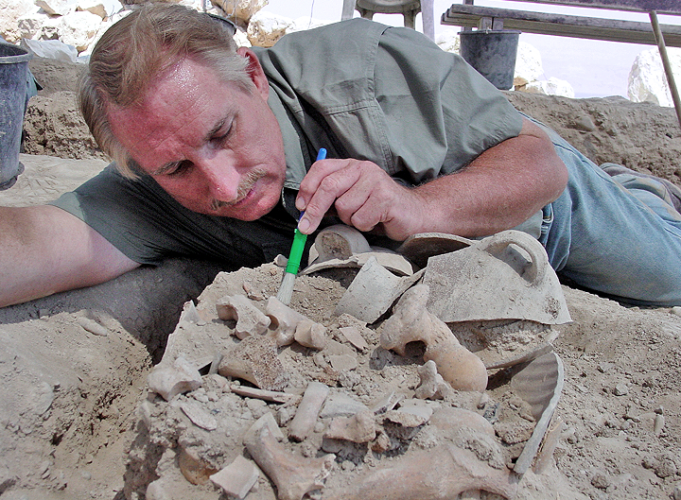
Dr. Price uncovering animal bone deposit at Qumran
(remains of the ritual meal based on the Messianic Banquet

Slide 50
Matthew 23:37-39/Luke 13:34-35
“O Jerusalem, Jerusalem, who kills the prophets and stones those who are sent to her! How often I wanted to gather your children together, the way a hen gathers her chicks under her wings, and you were unwilling. “Behold, your house is being left to you desolate! “For I say to you, from now on you shall not see Me until you say, ‘Blessed is He Who comes in the Name of the LORD!’”
“O Jerusalem, Jerusalem, the city that kills the prophets and stones those sent to her! How often I wanted to gather your children together, just as a hen gathers her brood under her wings, and you would not have it! “Behold, your house is left to you desolate; and I say to you, you shall not see Me until the time comes when you say, ‘Blessed is He Who comes in the Name of the LORD!’”

Slide 51
PSALM 118
19 Open to me the gates of righteousness; I shall enter through them, I
shall give thanks to the LORD.
20 This is the gate of the LORD; the righteous will enter through it.
21 I shall give thanks to You, for You have answered me; and You have
become my salvation.
22 The stone which the builders rejected has become the chief corner
stone.
23 This is the LORD’s doing; it is marvelous in our eyes.
24 This is the day which the LORD has made; let us rejoice and be glad in
it.
25 O LORD, do save, we beseech You; O LORD, we beseech You, do send
prosperity!
26 Blessed is the one who comes in the name of the LORD; we have
blessed you from the house of the LORD.
27 The LORD is God, and He has given us light; bind the festival sacrifice
with cords to the horns of the altar.

Slide 52
The Judgment of the Nations (Matthew 25:31-46)
“But when the Son of Man comes in His glory, and all the angels with Him, then He will sit on His glorious throne. And all the nations will be gathered before Him; and He will separate them from one another, as the shepherd separates the sheep from the goats; and He will put the sheep on His right, and the goats on the left. Then the King will say to those on His right, ‘Come, you who are blessed of My Father, inherit the kingdom prepared for you from the foundation of the world. ‘For I was hungry, and you gave Me something to eat; I was thirsty, and you gave Me drink; I was a stranger, and you invited Me in; naked, and you clothed Me; I was sick, and you visited Me; I was in prison, and you came to Me.’ Then the righteous will answer Him, saying, ‘Lord, when did we see You hungry, and feed You, or thirsty, and give You drink? ‘And when did we see You a stranger, and invite You in, or naked, and clothe You? ‘And when did we see You sick, or in prison, and come to You?’ “And the King will answer and say to them, ‘Truly I say to you, to the extent that you did it to one of these brothers of Mine, even the least of them, you did it to Me.’” (31-40)

Slide 53
“Then He will also say to those on His left, ‘Depart from Me, accursed ones, into the eternal fire which has been prepared for the devil and his angels; for I was hungry, and you gave Me nothing to eat; I was thirsty, and you gave Me nothing to drink; I was a stranger, and you did not invite Me in; naked, and you did not clothe Me; sick, and in prison, and you did not visit Me.’ Then they themselves also will answer, saying, ‘Lord, when did we see You hungry, or thirsty, or a stranger, or naked, or sick, or in prison, and did not take care of You?’ Then He will answer them, saying, ‘Truly I say to you, to the extent that you did not do it to one of the least of these [Yeshua’s brethren], you did not do it to Me.’ “And these will go away into eternal punishment, but the righteous into eternal life.” (41-46)

Slide 54
Acts 1:6-7
“And so when they had come together, they were asking Him, saying, ‘Lord, is it at this time You are restoring the kingdom to Israel?’ He said to them, ‘It is not for you to know times or epochs which the Father has fixed by His own authority’” …
Οἱ μὲν οὖν συνελθόντες ἠρώτων αὐτὸν λέγοντες· κύριε, εἰ ἐν τῷ χρόνῳ τούτῳ ἀποκαθιστάνεις τὴν βασιλείαν τῷ Ἰσραήλ; εἶπεν δὲ πρὸς αὐτούς· οὐχ ὑμῶν ἐστιν γνῶναι χρόνους ἢ καιροὺς οὓς ὁ πατὴρ ἔθετο ἐν τῇ ἰδίᾳ ἐξουσίᾳ …

Slide 55
“Jesus’ correction of the apostles … should not be taken to mean that Jesus acknowledges the old Jewish worldview and that its timing is now hidden from the apostles. Instead, Jesus is acknowledging their interpretation. He in effect says, ‘Yes, I will restore Israel – but in a way you cannot imagine.’”
Gary Burge, Wheaton College

Slide 56

What Did Jesus Say?
“To these He also presented Himself alive, after His suffering, by many convincing proofs, appearing to them over a period of forty days, and speaking of the things concerning the kingdom of God.”
Acts 1:3

Slide 57

“Is it at this time that
you are going to restore
the kingdom to Israel?"
Acts 1:6

Slide 58
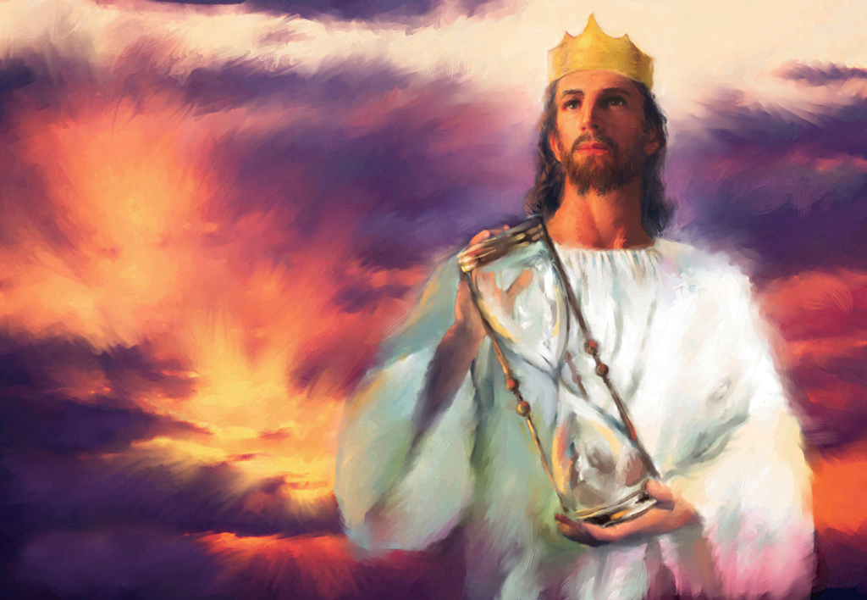
Jesus reply concerned the timing of the restoration,
not the truth of the restoration!
“He said to them,
‘It is not for you to know times or epochs which the Father has fixed
by His own
authority …”
Acts 1:7

Slide 59
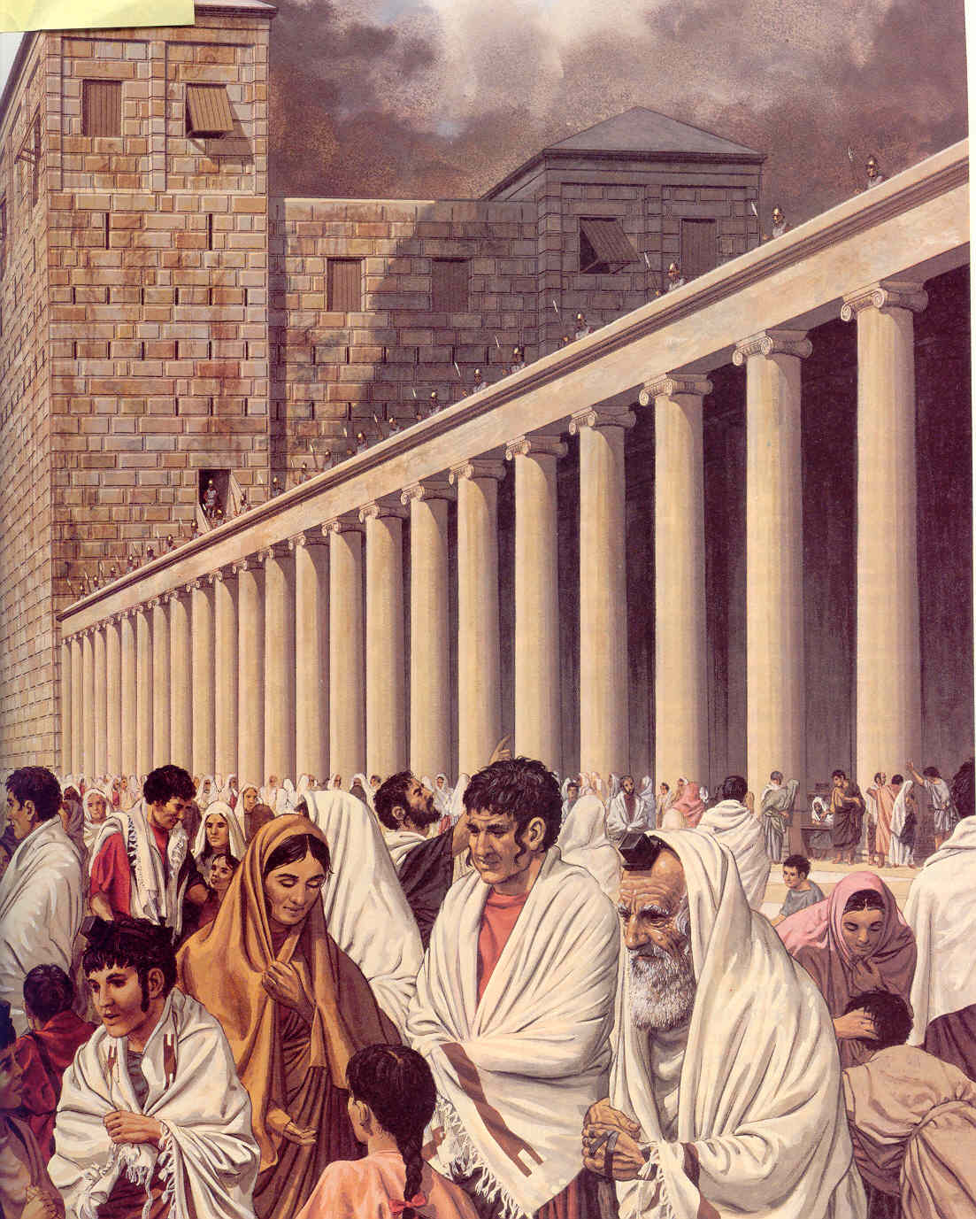
What Did Peter Say?
What Peter Said!
“But the things which God announced beforehand by the mouth of all the prophets, that His Christ should suffer, He has thus fulfilled. Repent therefore and return, that your sins may be wiped away, in order that times of refreshing may come from the presence of the Lord; and that He may send Yeshua ha-Mashiach appointed for you, whom heaven must receive until the period of restoration of all things about which God spoke by the mouth of His holy prophets from ancient time.” Acts 3:18-21

Slide 60

Conclusion
“the sense of the Old Testament text must be determined within its historical and cultural setting, and that sense is determinative for the New Testament fulfillment.” - Paul Feinberg
“New revelation cannot mean contradictory revelation [because] if this were so, the Bible would be filled with contradictions, and God would have to be conceived of as deceiving the Old Testament prophets when He revealed to them a nationalistic kingdom.” - C.C. Ryrie

